Slide 1
Secure data : hiding in images using steganography
CAPSTONE PROJECT
Presented By:
Student Name : Dev Kishan Prajapat
College Name & Department : Engineering College Bikaner (Electronics Instrumentation & Control Engineering)

Slide 2
OUTLINE
Problem Statement
Technology used
Wow factor
End users
Result
Conclusion
Git-hub Link

Slide 3
Problem Statement
In current scenario, all the computer devices are interconnected and thus, forms a computer network. Through this network, data is also shared. This calls for a robust and reliable method to embed sensitive information within seemingly simple digital media in plain sight, thereby mitigating the risk to detection and interception.

Slide 4
Technology used
Windows 10 or above
Python
OpenCv
OS
String
4 Gb or above RAM

Slide 5
Wow factors
Steganography for Encoding Messages: using image pixels to encode a secret message.
Encryption and Decryption: both encryption and decryption steps are included within the code, allowing for a complete cycle of hiding and revealing the message using a password.
Efficient Character Mapping: Using dictionaries to map characters to their ASCII values and vice versa is a smart approach for encoding and decoding the message..
Access Control with Password: added layer of security by requiring a passcode for decryption, ensuring that only authorized users can access the hidden message.

Slide 6
End users
Government and Military: may employ steganography to transmit sensitive information.
Corporate Sector: to protect proprietary information, such as intellectual property, during transmission over potentially insecure channels.
Journalists and Activists: journalists and activists may use image steganography to share sensitive information safely and securely, avoiding censorship and surveillance.

Slide 7
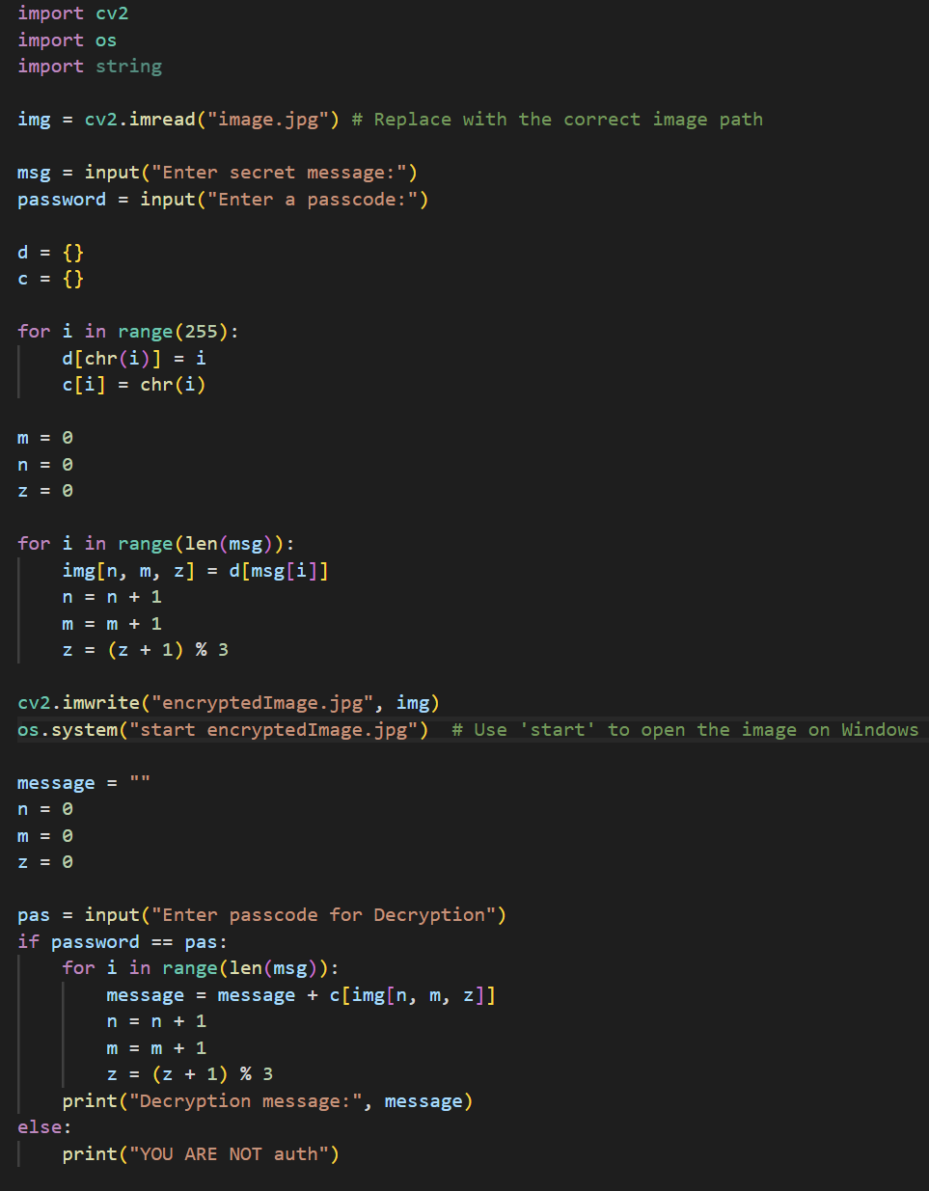
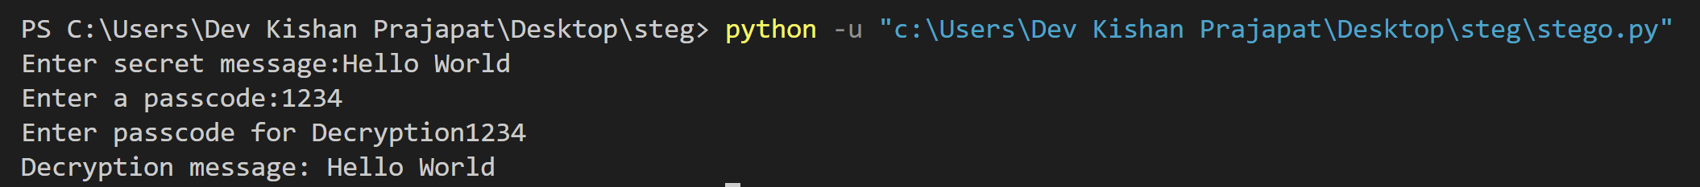

Results
Output
Encrypted Image
Code

Slide 8
Conclusion
This Steganography based project successfully demonstrates the practical application of hiding secret messages within images. By leveraging pixel manipulation, the project showcased how information can be covertly embedded into the RGB values of an image, making it an effective technique for secure communication.

Slide 9
GitHub Link
https://github.com/devkishan920/Steganography.git

Slide 10
THANK YOU

